Slide 1
FEEDBACK MANAGEMENT SYSTEM

Slide 2
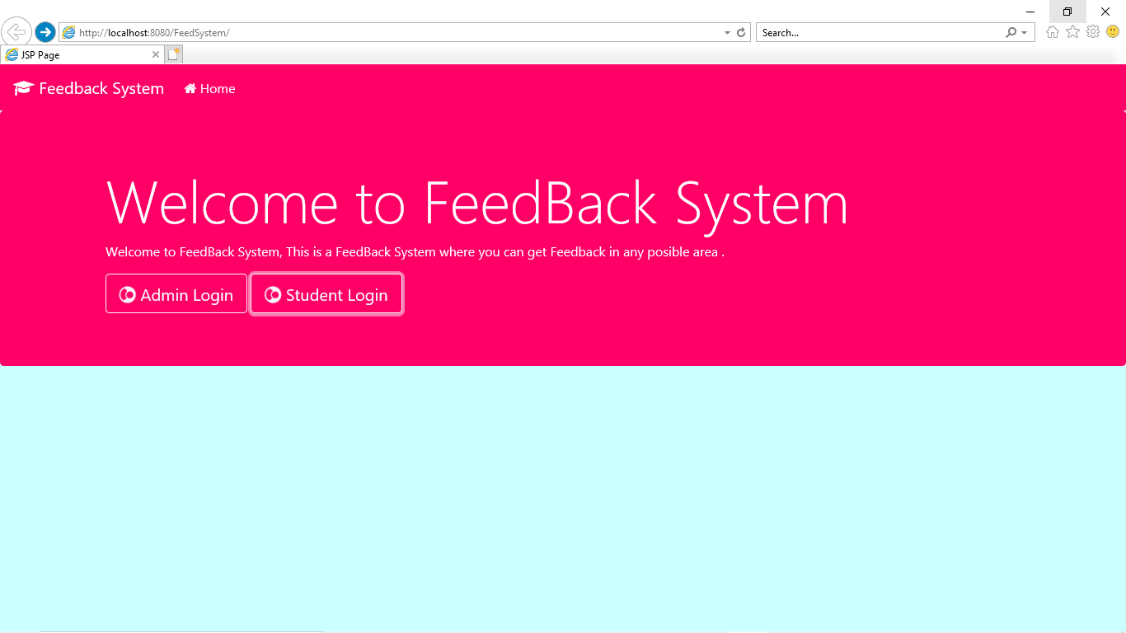
HOME PAGE

Slide 3
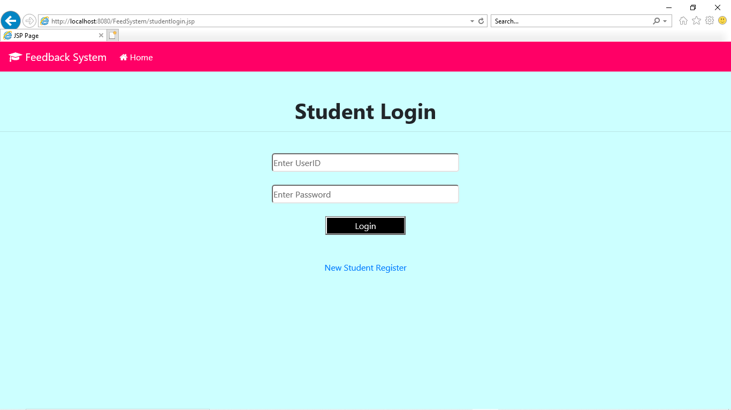
STUDENT LOGIN PAGE

Slide 4
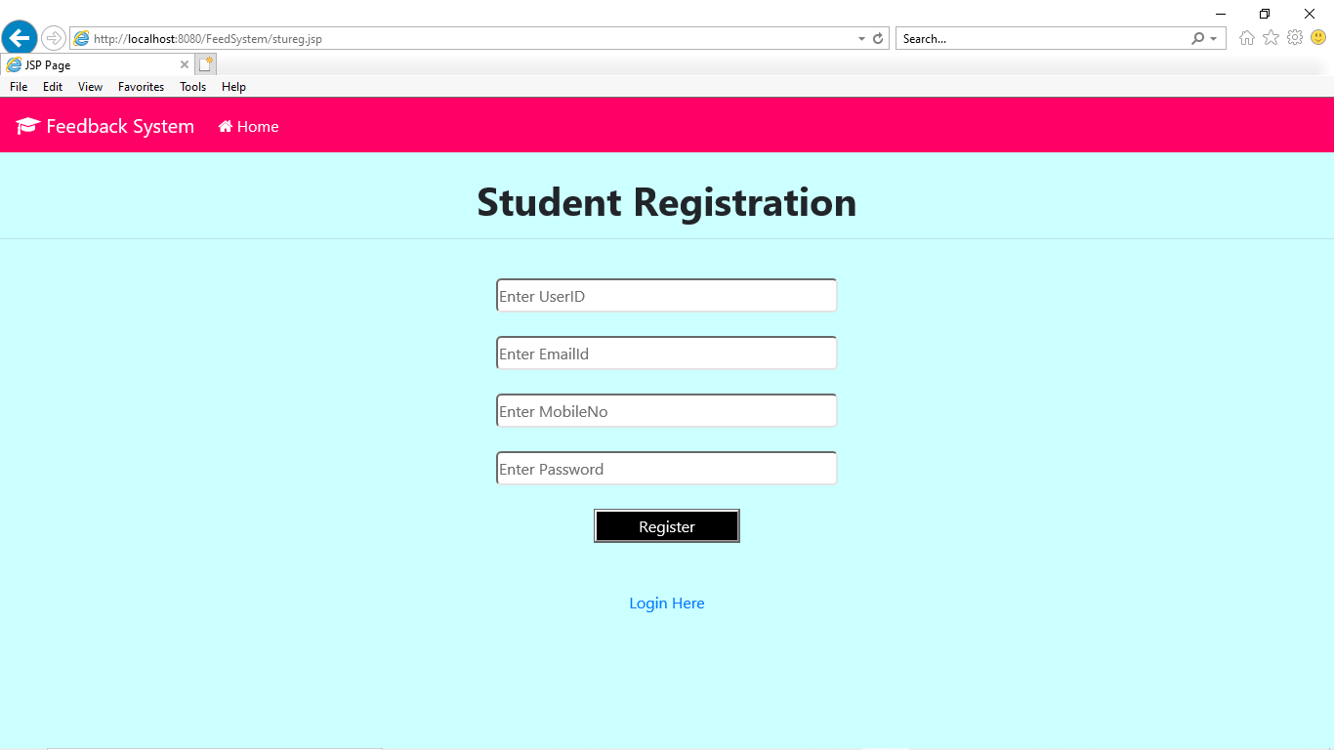
STUDENT REGISTRATION

Slide 5
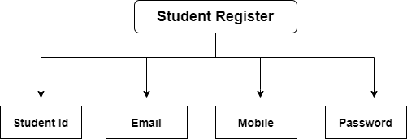
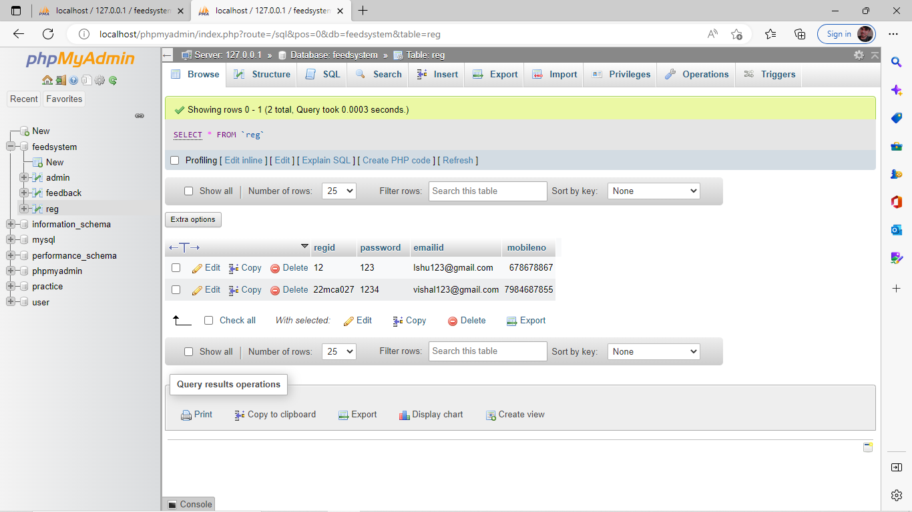
Student Register Database

Slide 6
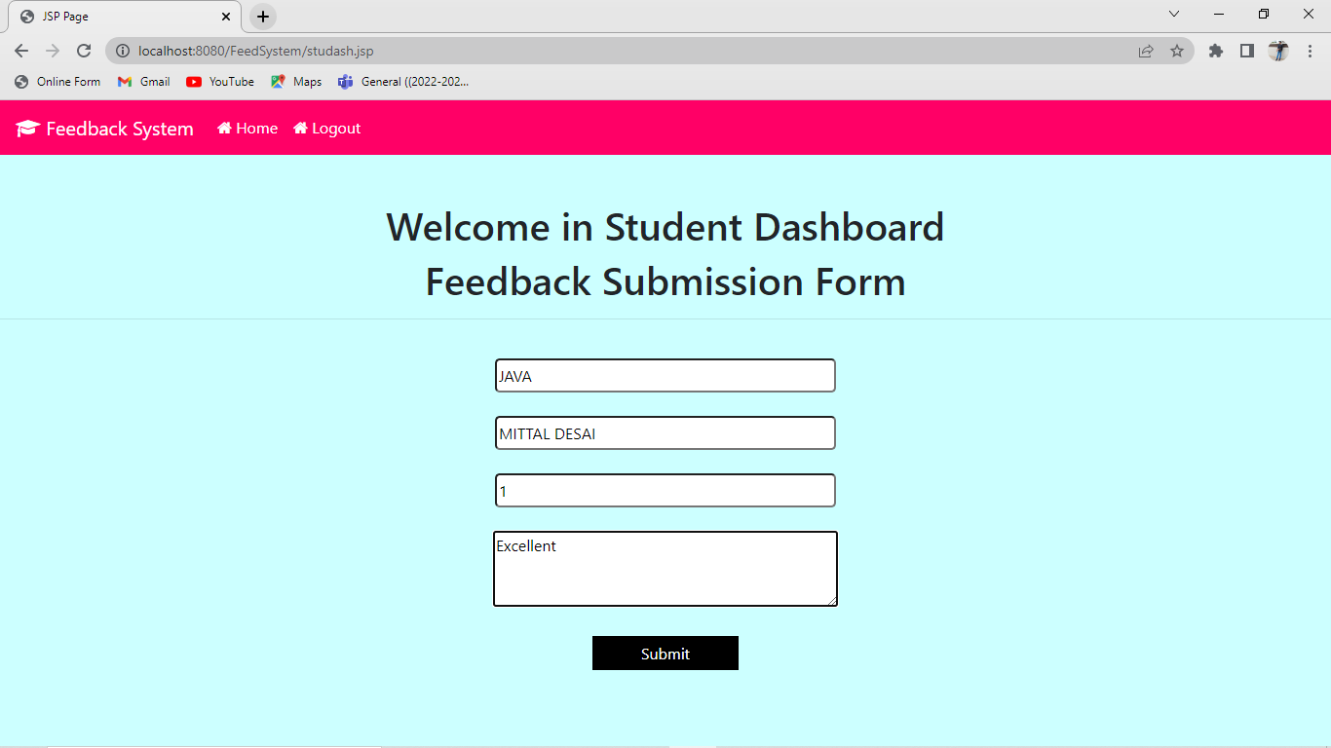
STUDENT DASHBOARD

Slide 7
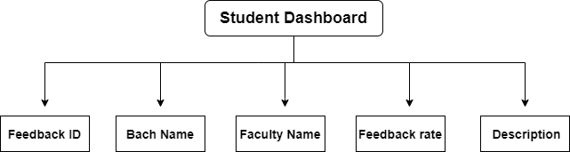
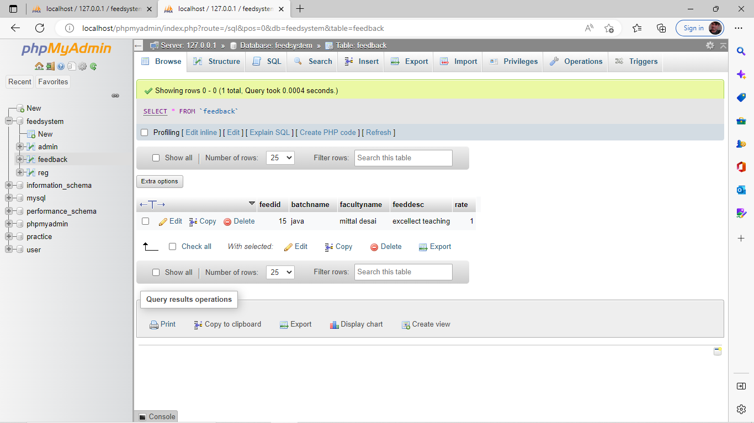
Student Dashboard Database

Slide 8
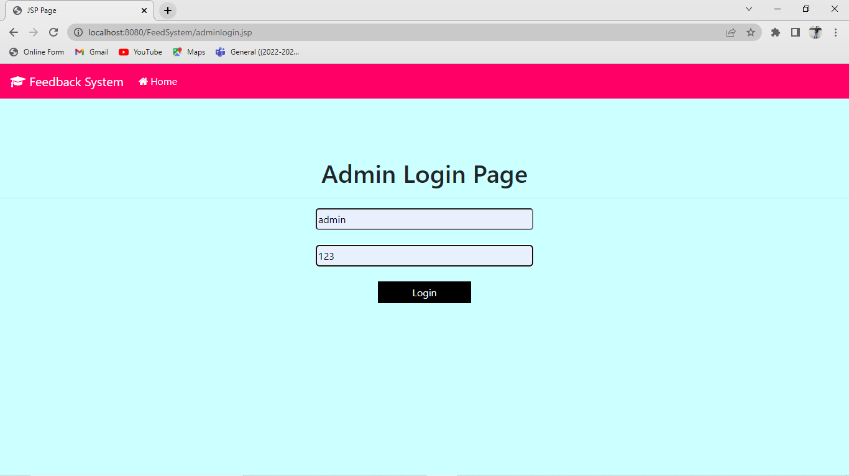
ADMIN LOGIN PAGE

Slide 9
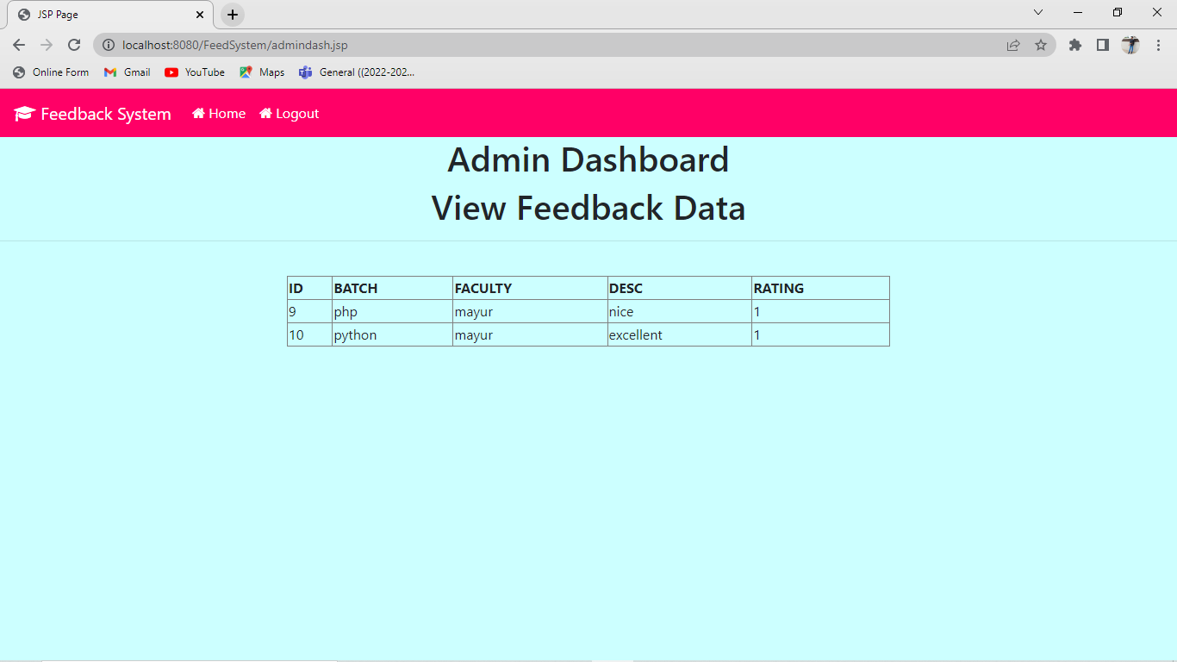
ADMIN DASHBOARD

